Slide 1

Rock 'n' Roll Marathon
An Analytic Avenger’s Production

Slide 2
Overall Data Characteristics
Half Marathon Year | Fastest | Slowest | Median | Mean
2016 | 1:11:15 | 4:54:41 | 2:26:18 | 2:31:57
2017 | 1:10:58 | 6:18:24 | 2:39:34 | 2:43:59
2018 | 1:09:25 | 4:48:06 | 2:25:32 | 2:31:46
2019 | 1:10:03 | 5:03:35 | 2:26:07 | 2:32:07
Full Marathon Year | Fastest | Slowest | Median | Mean
2016 | 2:25:42 | 7:00:00 | 4:45:19 | 4:47:48
2017 | 2:40:25 | 6:38:19 | 4:58:14 | 4:54:26
2018 | 2:28:16 | 6:34:41 | 4:48:21 | 4:48:23
2019 | 2:34:59 | 6:43:55 | 4:41:57 | 4:42:09

Slide 3
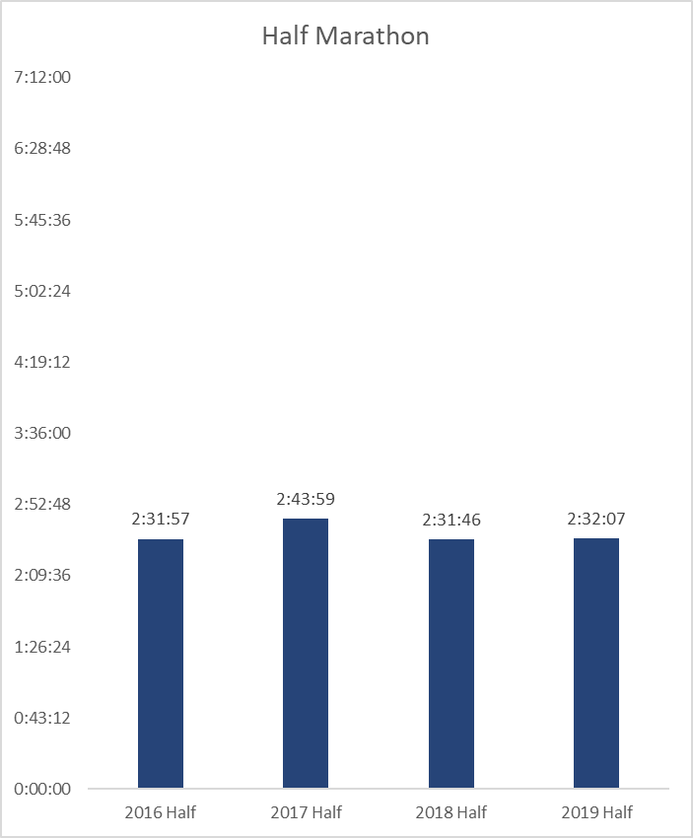
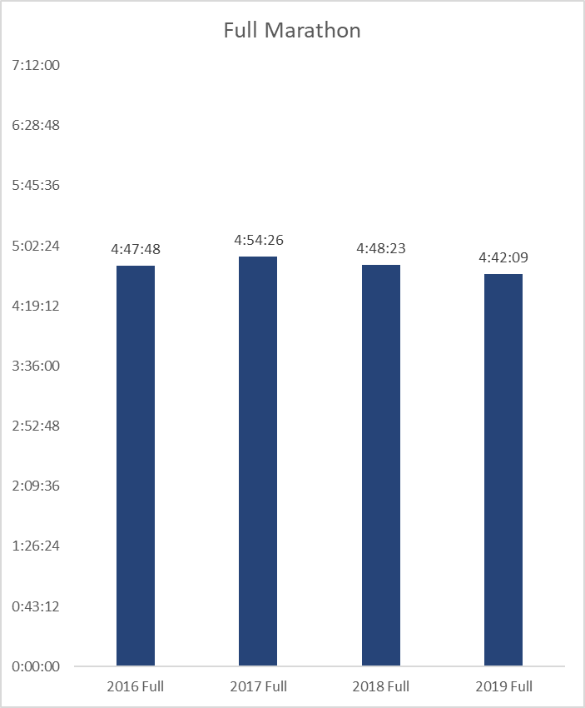
Mean Time by Year

Slide 4
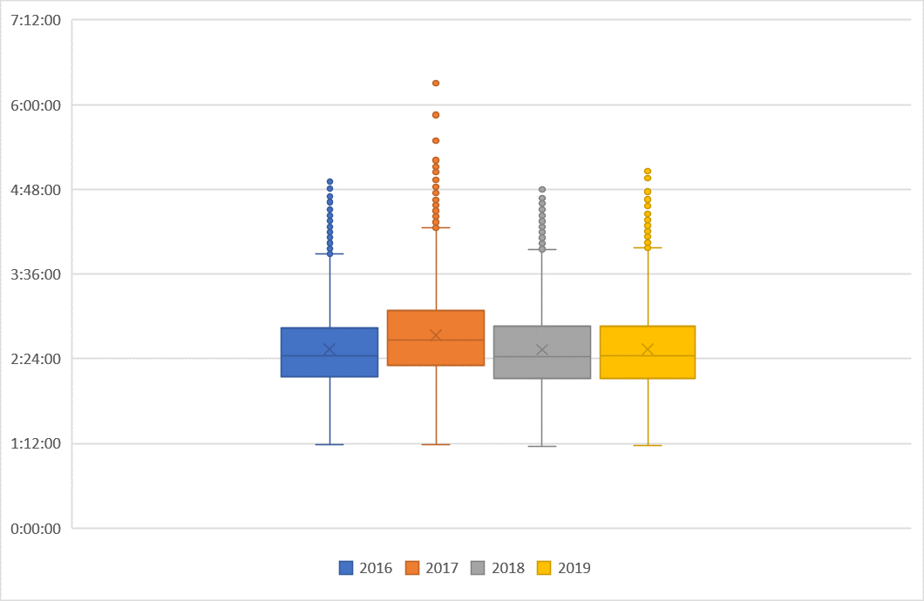
Half Marathon Times - Box and Whisker Plot

Slide 5
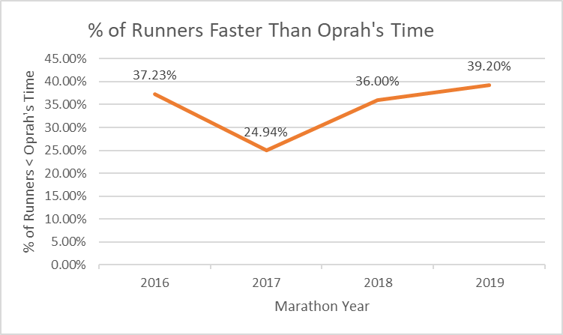
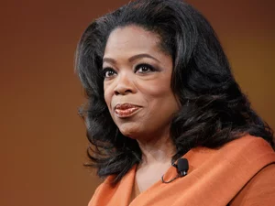
Are You Faster than Oprah?
Total Number of competitors
2016: 2953 competitors
2017: 2467 competitors
2018: 2101 competitors
2019: 2024 competitors
https://www.npr.org/2010/04/13/125856397/oprah-the-icon-gets-the-kitty-kelley-treatment

Slide 6
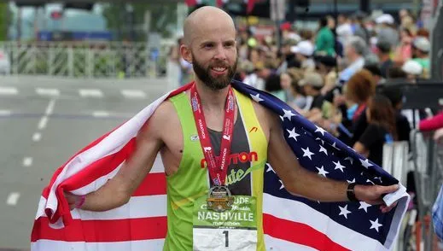
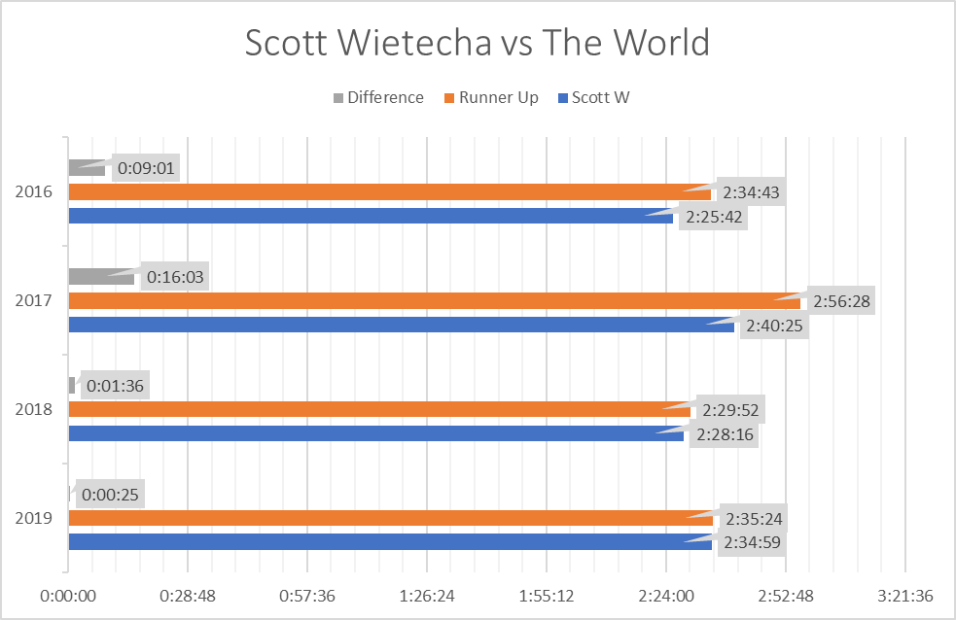
Scott Wietecha vs The World
Scott was the only participant to finish in the top 3 over all 4 years.
Scott’s average finish time was 2:32:30.
Scott’s finish time declined over time.
https://www.tennessean.com/story/sports/2021/11/18/nashville-marathon-winner-2021-scott-wietecha/8586785002/

Slide 7
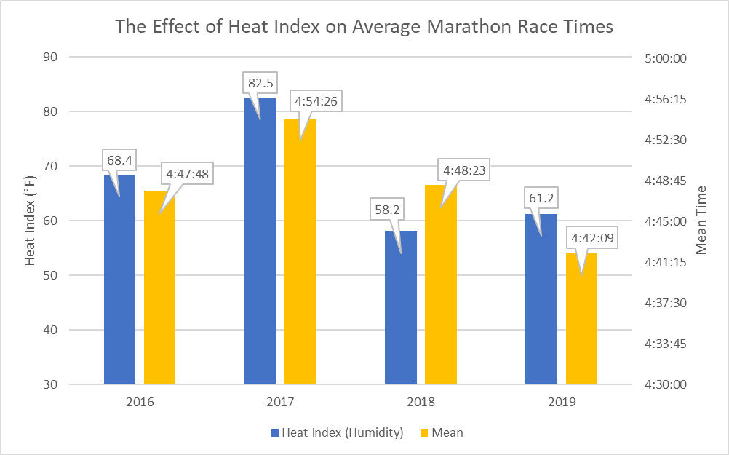
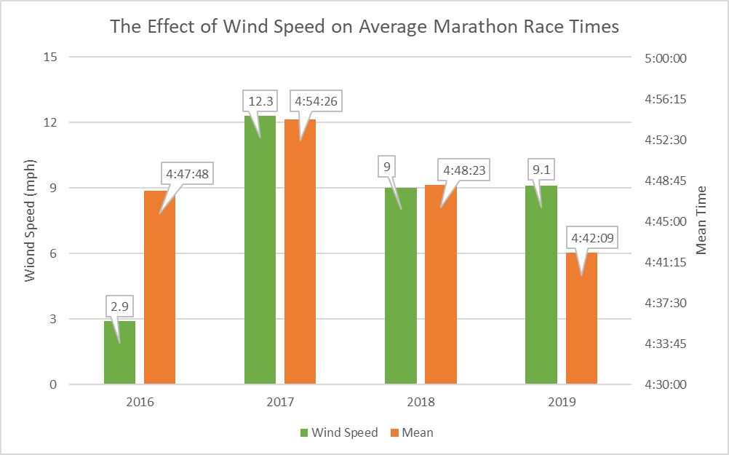
Difference Between Years
Mean times were within 15 minutes, but 2017 was substantially slower.
2017 was substantially more humid than other years, and wind speed was also the highest.
“With the conditions being what they were — hot and humid — I didn’t care about my finishing time.” - Scott Wietecha, after 2017’s race.
2019’s time was the fastest despite similar conditions to 2018, but some course changes were made that year.
Source: https://www.tennessean.com/story/sports/2017/04/29/wietecha-wins-nashville-marathon/101009638/

